Slide 1
Homework at Sibsey Primary School
OCTOBER 2020

Slide 2
Aims for the session
Touch on the remote learning agenda
Share key points of new homework setup
Explain rationale of digital homework
Share some key survey response information
Show the steps to hand in work on Google Classroom

Slide 3
Zoom Meeting
Please stay on mute to avoid feedback
The meeting is being recorded
It’s nice to keep your camera on – please remember that everyone can see you!
Technology is unpredictable!!

Slide 4
Homework ‘types’
There’s not enough homework. | There’s normally the right amount of homework.
There’s too much homework. | Any piece of homework is too much!

Slide 5
Homework ‘types’
There’s not enough homework. | There’s normally the right amount of homework.
There’s too much homework. | Any piece of homework is too much!
Adults’ view + Child’s view!
Disclaimer – a range of perspectives within our parent community

Slide 6
Research into Homework
There have been extensive studies into homework
at primary and secondary level. EEF:
“It is certainly the case that schools whose pupils do homework tend to be more successful.”
https://educationendowmentfoundation.org.uk/evidence-summaries/teaching-learning-toolkit/homework-primary/

Slide 7
Show of hands…
How many of you have children in secondary school?

Slide 8
Homework – the reality
The research is more extensive into the value that homework brings to student success at secondary school level than primary school level. However, as part of our duty to prepare children for the future, we must never lose sight of the fact they are always getting ready for their next stage of learning.

Slide 9
Homework – preparing for future
For children from Year 7 onwards, there is a huge transition into self-policing and self-managing homework. It can become a battle point in households!!!
The reality is some weeks, it comes thick and fast from all subjects and you may be thinking nostalgically back to the primary school amount(!)

Slide 10
Homework – preparing for future
It is therefore really important for your child’s success and happiness in the future that good homework habits are instilled early.
That can be easy for some and easier said than done for others!

Slide 11
Homework – preparing for future
Ultimately, the reality is that you
are preparing your child to grow up and be
self-sufficient and as happy and successful as possible. If you have negative memories of homework and or bad experiences, they will inherently be passed on but that doesn’t mean that they can’t be improved!

Slide 12
Updated progression map
We have updated a progression map of homework expectations across the school.
This is based on minimum expectation but the commitment from families and children to stick to the routine.
I will add this document to our website.

Slide 13
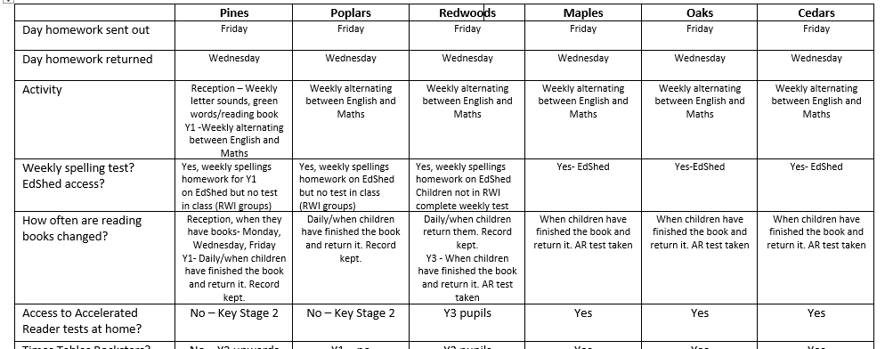
Homework across the school
The first time you use Google Classroom,
you will get a lot of pop ups telling you what
to do. Click through them and they won’t appear
next time.

Slide 14
Homework across the school
The first time you use Google Classroom,
you will get a lot of pop ups telling you what
to do. Click through them and they won’t appear
next time.

Slide 15
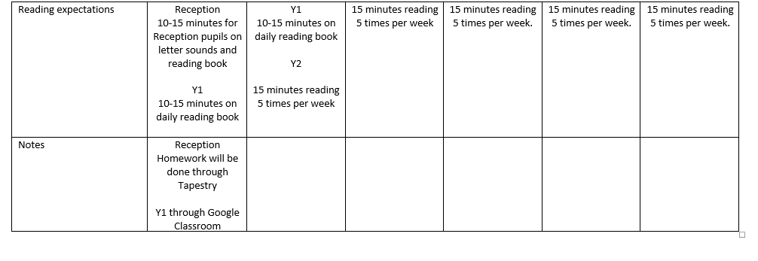
Homework across the school
The first time you use Google Classroom,
you will get a lot of pop ups telling you what
to do. Click through them and they won’t appear
next time.

Slide 16
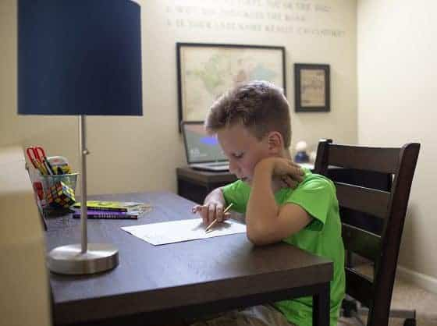
Homework – the promised land!
Ideally, your child will be (age-depending of course!) able to access the work with you being there to support or ask questions but not having to do the work for them.

Slide 17
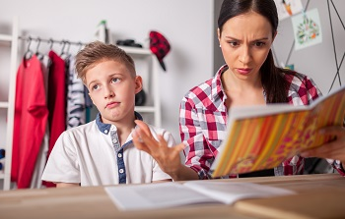
Homework – what it sometimes looks like!

Slide 18
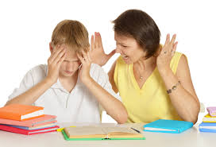
Homework – what value if it looks like this?

Slide 19
What has Home Schooling taught you?
Not one parent has told me that every day was perfect
Some have said how nice it has been to see their child’s capabilities and next steps is in more depth
So many creative and wonderful experiences
Some great connections between parents and children
Some fallouts and huge rows – children telling parents they’re not their teacher!
A lot of flexibility needed

Slide 20
What has Home Schooling taught us?
Staff have done extensive analysis of the assessments completed within the first month of school return. We have found that the skill (decoding) of reading has not been impacted as significantly as other areas but inference (the ability to read between the lines) has been impacted. Being able to read is one thing but how deeply can children show how well they understand the text?

Slide 21
What has Home Schooling taught us?
In writing, understanding of grammar terminology has slipped and stamina for writing has also been impacted by school closure.
In maths, some key arithmetic skills have not been significantly impacted but reasoning skills and problem solving have been.

Slide 22
What has Home Schooling taught us all?
Children are just as creative as ever
Children’s imaginations are still in tact
Children have adapted incredibly well
Children have responded to changes very well

Slide 23
Successful Homework depends on…
Headspace – it can fail before it’s started!
Time and resources
Both in the right frame of mind
Parent understanding the activity – if you know what the success of it looks like, that’s really important
Work towards independence (even a little bit at a time)
It doesn’t take unnecessarily long
It ends on a good note

Slide 24
Clashes can come when…
There’s limited or no patience (from one party!)
You’re trying to fit it in too quickly
You show a method which you know works but your child is not familiar with
Your child doesn’t remember something you think they should!

Slide 25
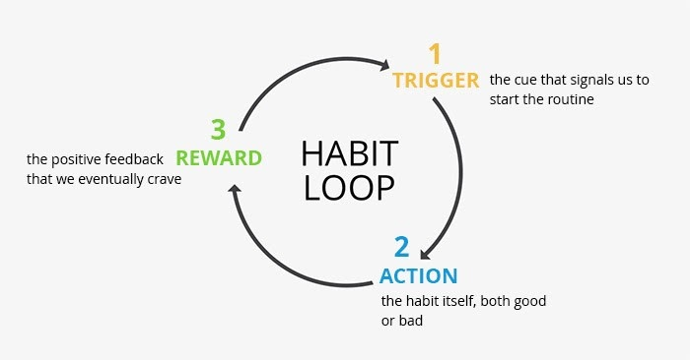
Homework – creating a habit loop
This can have a
significant positive
impact in school for
your child.

Slide 26
Homework at Sibsey
In a new paperless age

Slide 27
Why Google Classroom?
We looked at Microsoft Teams but found it slightly more “business-like” for our children to use. We use it as a staff for remote meetings. As we have implemented a remote learning plan for Sibsey, Google Classroom is a huge part of that and that’s why we are using it for homework. It also reduces the amount that a child needs to bring into school. If a child has to have 14 days off, or we have to close down part of the school (or the whole school) then this means learning will be less disrupted.

Slide 28
Surely…not another thing!!!
Google Classroom
Accelerated Reader
Times Tables Rockstars
Numbots
EdShed
The unfortunate reality is that since March we have all had to make so many changes and adaptations to what we would call normal. Perhaps the age of convention is over!
We have to keep getting used to new things all the time.

Slide 29
An opportunity
TTR, AR, EdShed, Numbots are all very intuitive and once up and running extremely easy to use.
Progress can be tracked and usage is monitored. Challenges can be set by school, personal targets and levels can be set, rewards given and lots of children really like the software.
Children can be self-sufficient with a bit of rehearsal!

Slide 30
Survey responses

Slide 31
Survey responses

Slide 32
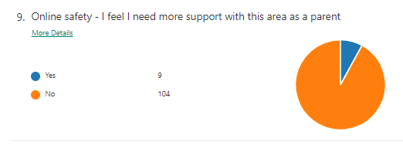
Survey responses

Slide 33
Google Classroom

Slide 34
Codes for Google Classroom
Pines - jyu7zea
Poplars - d42sra4
Redwoods - ifpnbpw
Maples - bbznttl
Oaks - x6zr7ed
Cedars – 7wyco7x

Slide 35
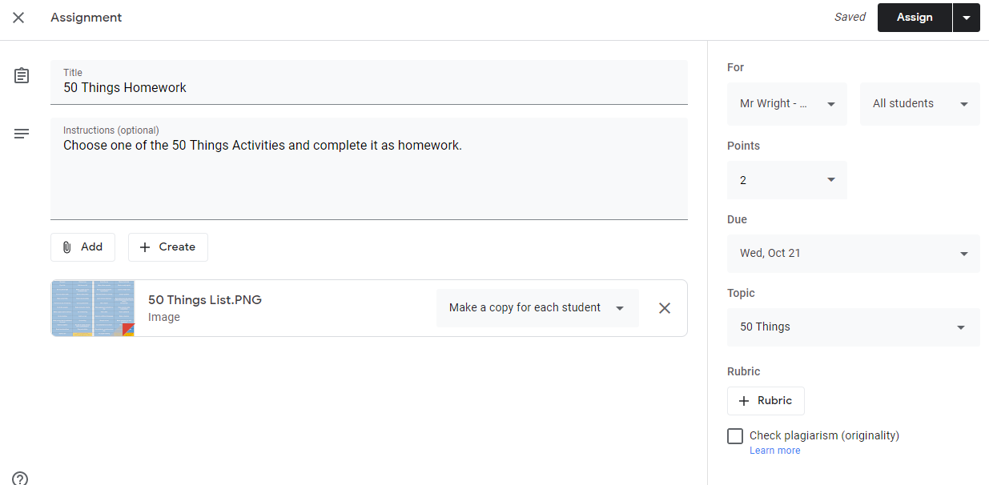
Setting work and handing it in

Slide 36
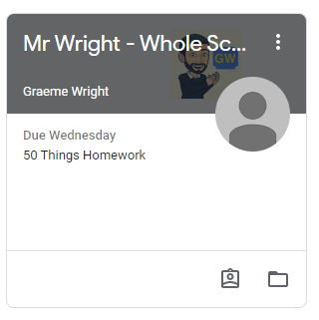
Setting work and handing it in

Slide 37
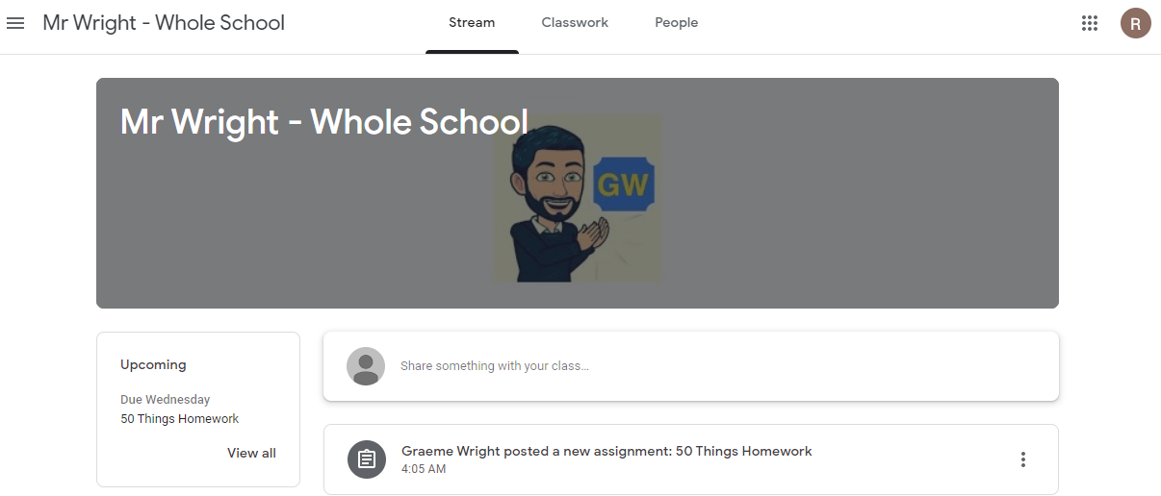
Setting work and handing it in

Slide 38
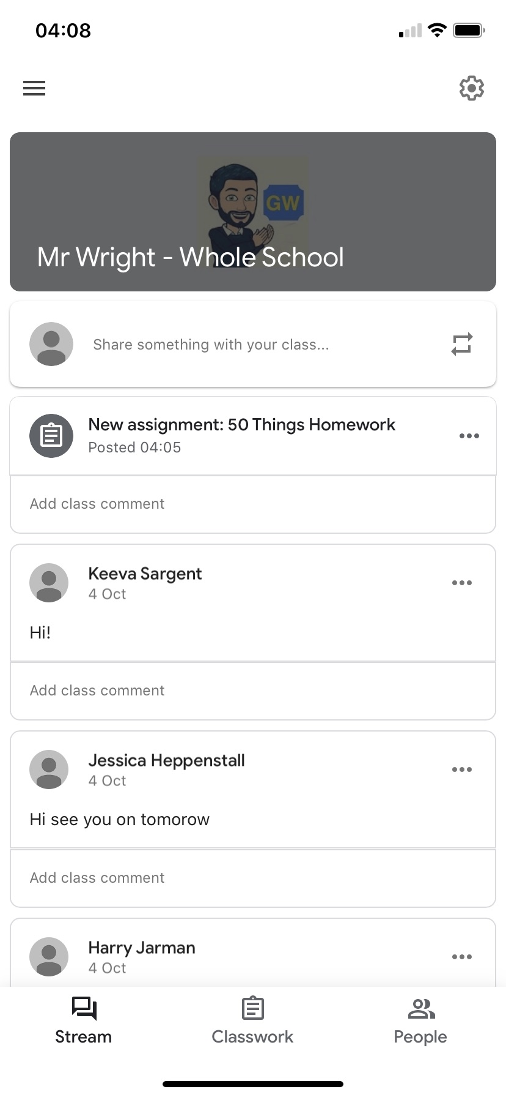
Setting work and handing it in

Slide 39
Setting work and handing it in

Slide 40
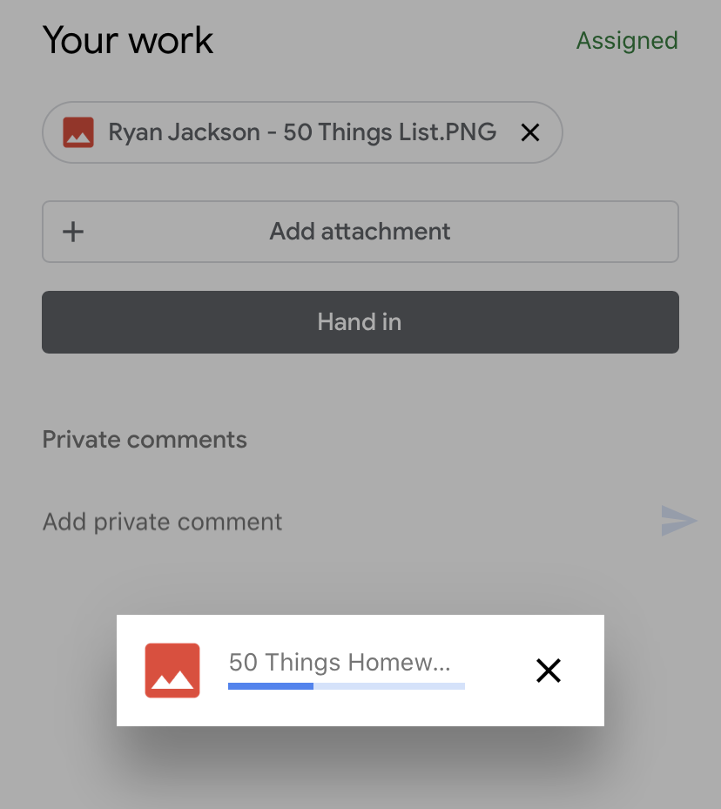
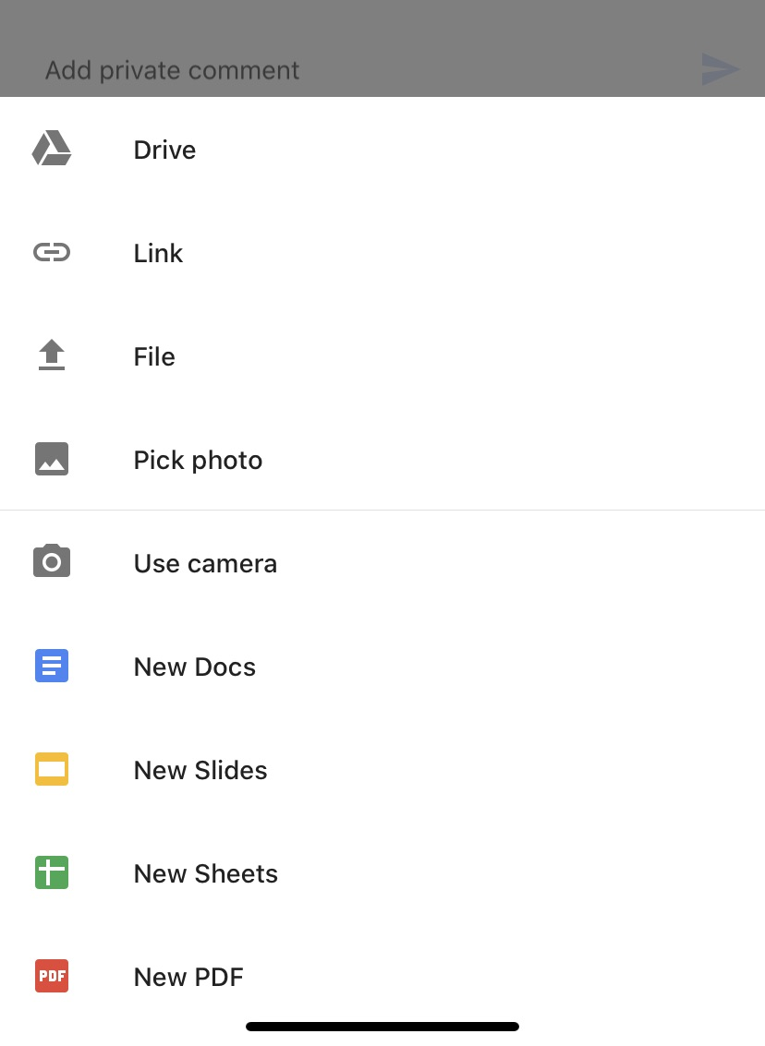
Setting work and handing it in

Slide 41
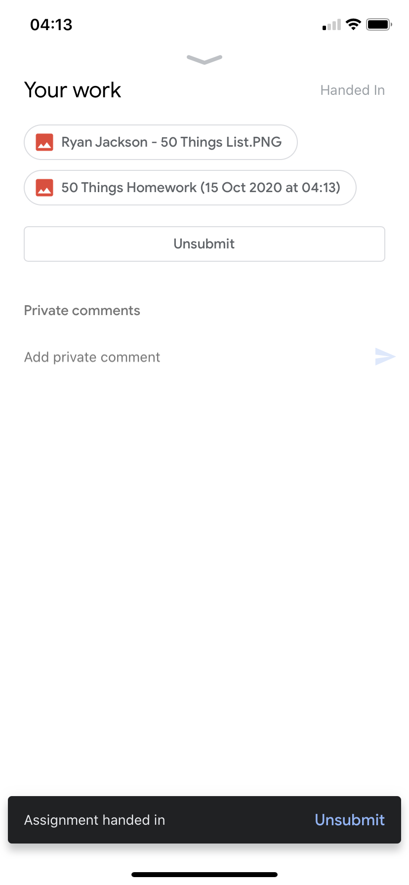
Setting work and handing it in

Slide 42
Steps
Log in to the class
See upcoming events or click on classwork
Download homework file/read instructions
Complete it in your homework book
Take a good photo of the work (portrait works best)
Hand it in

Slide 43
Setting work and turning it in
If you make a mistake, you can choose to unsubmit and then go through the stages again. You won’t lose anything you had previously submitted so you will have to delete those files. Just don’t forget to resubmit afterwards!

Slide 44
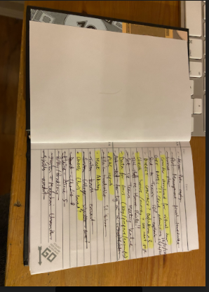
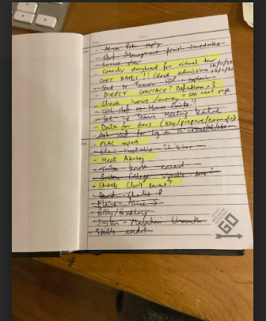
Setting work and turning it in

Slide 45
Recommendations
If you download the app, you can control
homework predominantly from your phone.
You will be able to see what is set, download
any attachments and upload the homework
as a photo/photos straight away.

Slide 46
Recommendations
If you download the app, you can control
homework predominantly from your phone.
You will be able to see what is set, download
any attachments and upload the homework
as a photo/photos straight away.

Slide 47
Recommendations
The first time you use Google Classroom,
you will get a lot of pop ups telling you what
to do. Click through them and they won’t appear
next time.

Slide 48
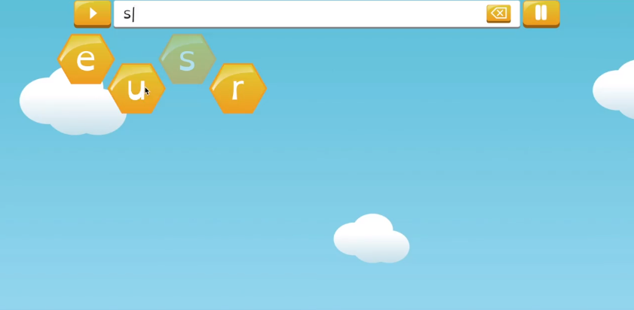
EdShed

Slide 49
EdShed

Slide 50
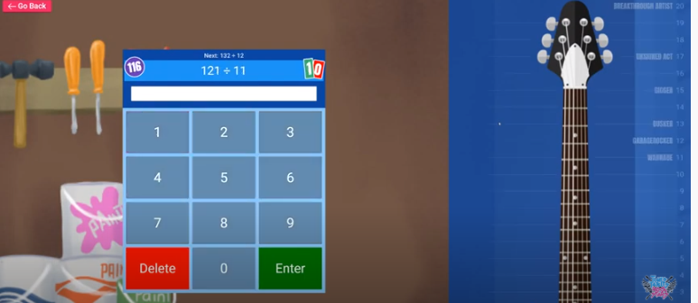
Times Table Rockstars

Slide 51
Accelerated Reader
You have to access it through the dedicated URL to school, not just search on Google.

Slide 52
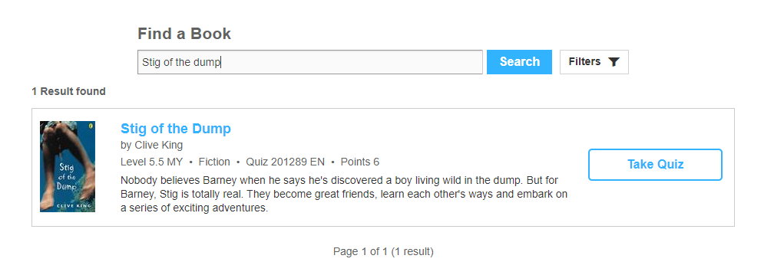
Accelerated Reader

Slide 53
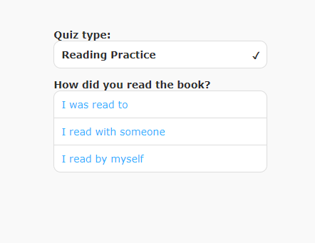
Accelerated Reader

Slide 54
Summary
Homework starts on Google Classroom tomorrow for Years 1 to 6 – sign up using the code, Reception pupils will continue with sounds etc.
Your child’s homework book will stay at home, you will send in photos of the work completed
Consider if you need to re-establish rules that you had in during school closure or set up new ground rules
Work will be marked and comments put back on Google Classroom
Be patient – it is intuitive but there will undoubtedly be problems
There is no requirement for you to print activities
Never spend an unnecessary amount of time on homework

